Slide 1

Large Language Models
Created by:
Urvesh Koshti,
Kern AG, Freiburg im Breisgau

Slide 2
Agenda:
What is Large Language Model (LLM)
Architecture of Large Language Model
Examples of Large Language Model
Present Large Language Models
Use cases of Large Language Model
Chatbot using Large Language Model

Slide 3


What is Large Language Model (LLM)?
A Large Language Model (LLM) is a type of artificial intelligence that uses deep learning techniques, particularly transformer-based neural networks, to process and generate human-like text. These models are trained on vast datasets comprising diverse text sources, enabling them to understand context, perform language translation, answer questions, and generate coherent text [1].
Large Language Models are super smart computers that can understand and talk like humans. They learn from reading lots of books and websites to help answer questions and tell stories.
[1] Reference: Radford, A., Wu, J., Child, R., Luan, D., Amodei, D., & Sutskever, I. (2019). Language Models are Unsupervised Multitask Learners. OpenAI.

Slide 4
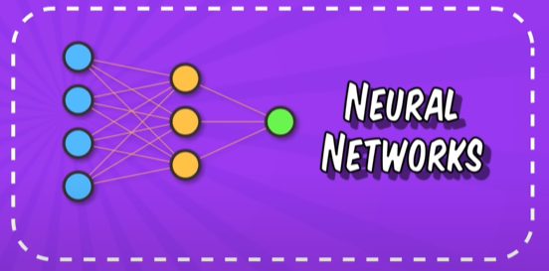
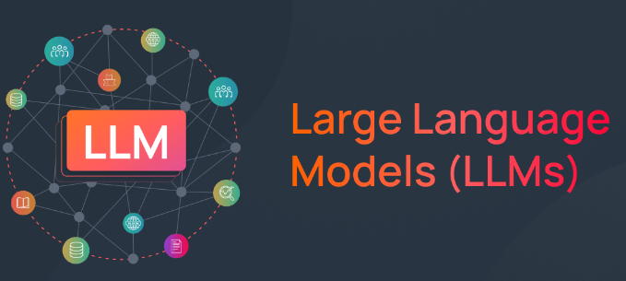
What is Large Language Model (LLM)?
A Language Model is like a Stochastic Parrot!!
Mom, I am hungry, can you serve some Biryani?
The table is broken. Let’s sit on the floor.
Training
Data
We went to watch a movie. And it was amazing.
I have an exam tomorrow. So I have to study.
…………………
Feeling Hungry, I would like to eat some ‘Biryani’
Sentence written by the User
Prediction by the LLM

Slide 5
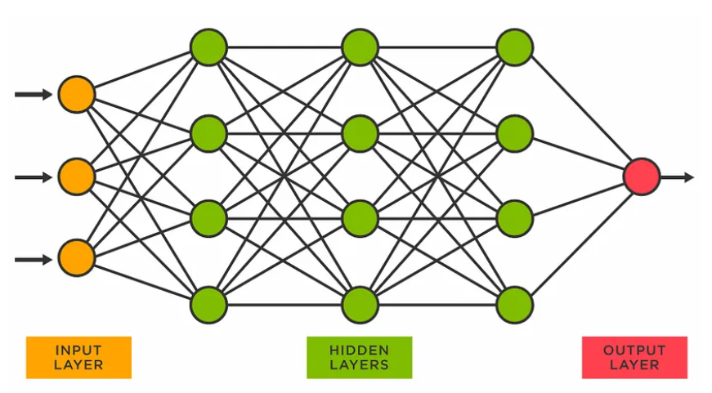
Architecture of Large Language Model (LLM)
Mom, I am hungry, can you serve some Biryani?
The table is broken. Let’s sit on the floor.
Input
Data
Output
We went to watch a movie. And it was amazing.
I have an exam tomorrow. So I have to study.
…………………
Architecture name: Transformers
Paper name: Attention All You Need:
Vaswani, A., Shazeer, N., Parmar, N., Uszkoreit, J., Jones, L., Gomez, A. N., Kaiser, Ł., & Polosukhin, I. (2017). Attention Is All You Need. Advances in Neural Information Processing Systems, 30, 5998-6008.

Slide 6
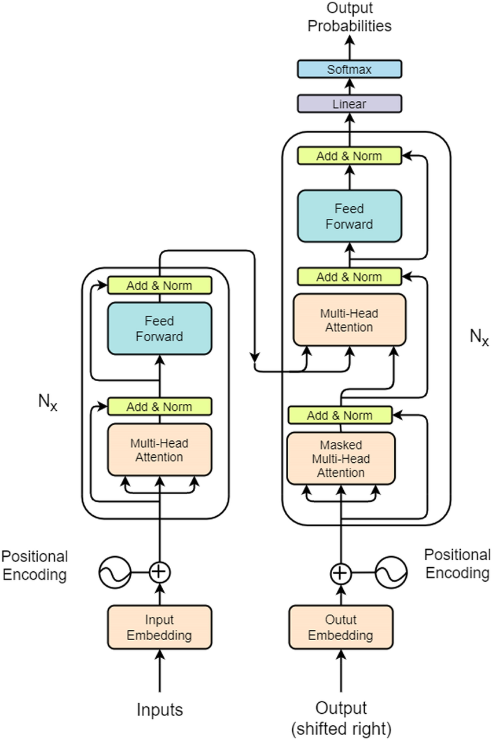
Architecture of Large Language Model (LLM)
Transformer:
Encoder
+ Decoder
+ Attention Mechanism
Paper name: Attention All You Need:
Vaswani, A., Shazeer, N., Parmar, N., Uszkoreit, J., Jones, L., Gomez, A. N., Kaiser, Ł., & Polosukhin, I. (2017). Attention Is All You Need. Advances in Neural Information Processing Systems, 30, 5998-6008.

Slide 7
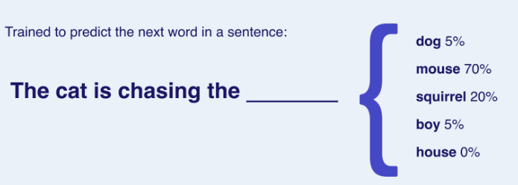
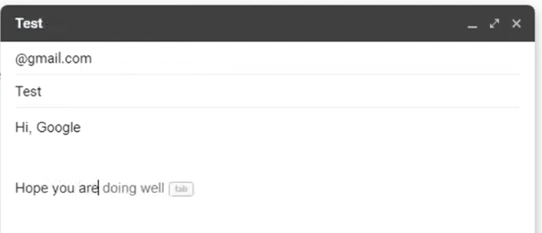
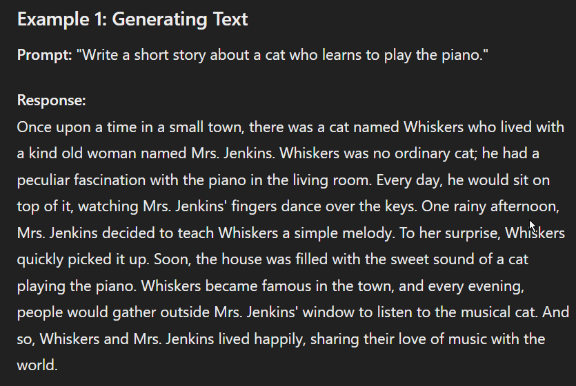
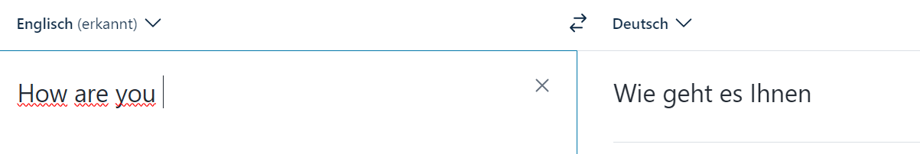
Examples Large Language Model (LLM)
Example 1
Example 3
Example 2
Example 4

Slide 8
Present Large Language Models (LLM)
ChatGPT (Generative Pre-Trained Transformer)
Gemini
Deepseek Coder
Mistral
….

Slide 9
Use cases of Large Language Models (LLM)
Content Creation
Sentiment Analysis
Customer Support
Language Translation
Programming Assistance
Summarization and Analysis
Recommendation Systems
…..

Slide 10



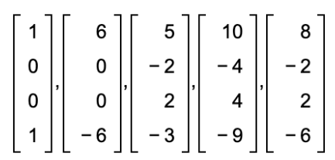




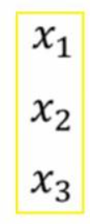
Chatbot using Large Language Models (LLM)
Purpose of my Task: To create the Chatbot (like ChatGPT) using any Open Source LLM.
Data Preparation
Prediction
Documents
Generated Answer
User
Question
Extract the text from documents
Create an entire database of vectors
Open Source LLM like ChatGPT
Similarity Search
Divide the question into chunks
Divide the text in different chunks
Further Training of already pretrained Model
Representation of each chunk into numerical representation
Represent text from each chunk into numerical vectors

